Slide 1



GENETIC DISORDERS
UNIVERSITY INSTITUTE OF ENGINEERING
Academic Unit V
Bachelor of Engineering
(Computer Science & Engineering)
Biology For Engineers
23SZT-148
GENETIC DISORDERS
DISCOVER . LEARN . EMPOWER

Slide 2
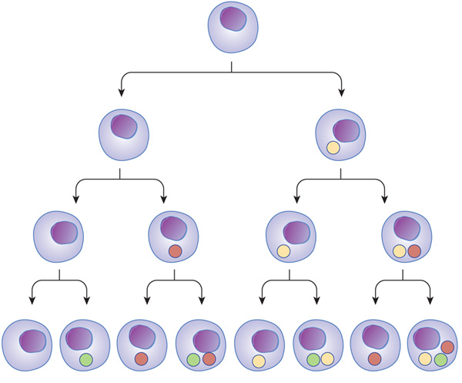
Course Outcome
CO Number | Title | Level
CO1 | Identify the biological concepts from an engineering perspective. | knowledge
CO2 | Development of artificial systems mimicking human action. | Understand
CO3 | Explain the basic of genetics that helps to identify and formulate problems | Analyze
CO4 | Apply knowledge of measurement system, biomedical recording system and biosensors to excel in areas such as entrepreneurship, medicine, government, and education. | Apply
CO5 | Integrate biological principles for developing next generation technologies, | Create
Will be covered in this lecture
https://www.nature.com/scitable/content/ne0000/ne0000/ne0000/ne0000/14707620/U2CP3-4B_RegulProteinsLoop_ksm.jpg

Slide 3
SYLLABUS
Unit-1 | Importance of Biology In Engineering | Contact Hours: 15
Chapter 1 Significance of Biology in Engineering Chapter 2 Genetics | Introduction: Fundamental Differences between Science and engineering by drawing a comparison between eye and camera, Bird flying and aircraft. Significance of Biology in Engineering, Discuss how biological observations of 18th Century that lead to major discoveries, Examples from Brownian motion and the origin of thermodynamics by referring to the original observation of Robert and Julius Mayor. Genetics: Mendel’s laws, Concept of segregation and independent assortment, concept of allele, gene mapping, Gene interaction, Epitasis, Meiosis and Mitosis as a part of genetics. Mechanism of how genetic material passes from parent to offspring. Concepts of recessiveness and dominance. Concept of mapping of phenotype to Genes, single gene disorders in humans, concept of complementation using human genetics.

Slide 4
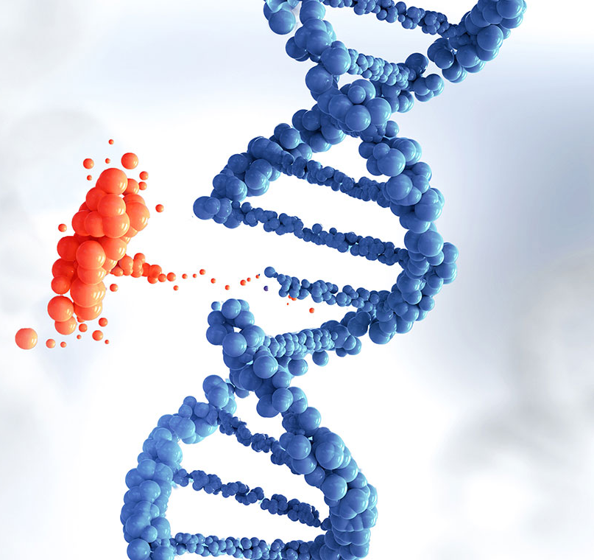
Genetic disorders
An inherited medical condition caused by a DNA abnormality.
A genetic disorder is a disease that is caused by a change, or mutation, in an individual's DNA sequence. A genetic disorder is an illness caused by changes in a person's DNA.
Genetic disorders can be caused by a mutation in one gene (monogenic disorder), by mutations in multiple genes (multifactorial inheritance disorder), by a combination of gene mutations and environmental factors, or by damage to chromosomes (changes in the number or structure of entire chromosomes)

Slide 5
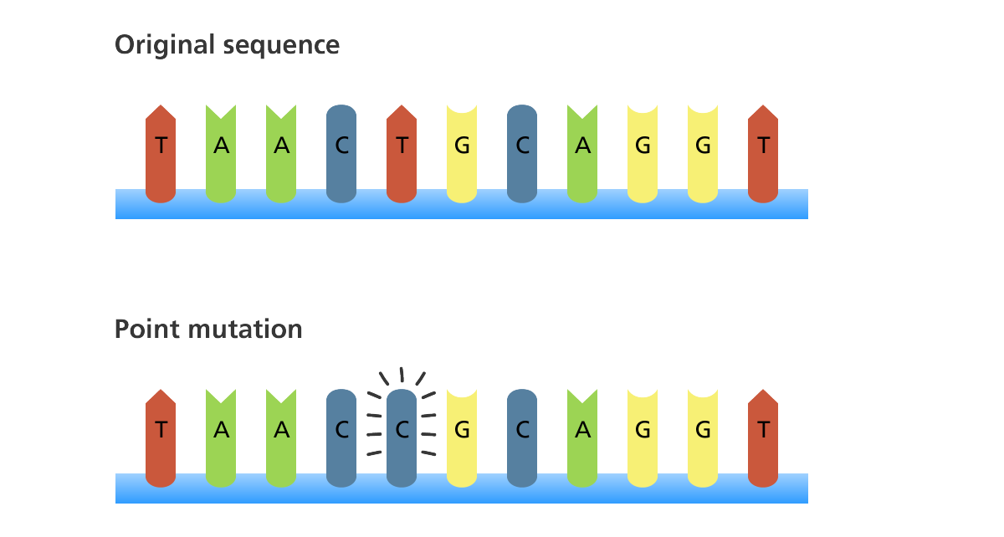
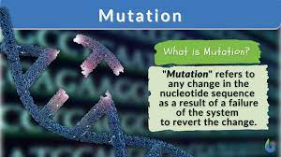

Slide 6
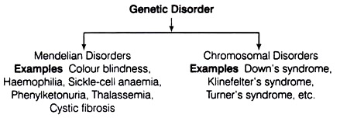

Slide 7
Mendelian Disorders:
These are mainly determined by alteration or mutation in the single gene. These disorders are transmitted in next generation.
For example,
Hemophilia, Sickle cell anemia etc.

Slide 8
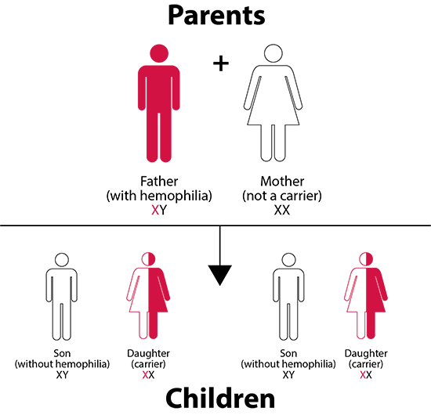
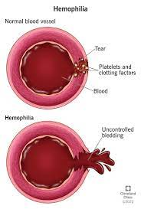
Haemophilia:
Genetic disorder
Defect in blood coagulation mechanism.
It is a recessive disease, which is transmitted from an unaffected carrier offspring's. Due to this, patient continues bleeding even on a minor injury because of defective blood coagulation.

Slide 9
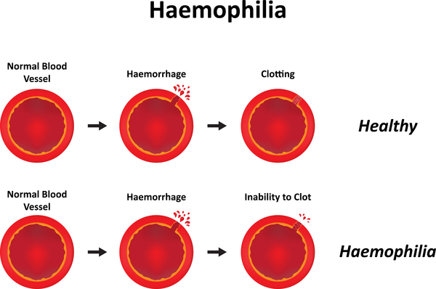
Prothrombin- Fibrinogen factor 1- Responsible for blood clotting

Slide 10
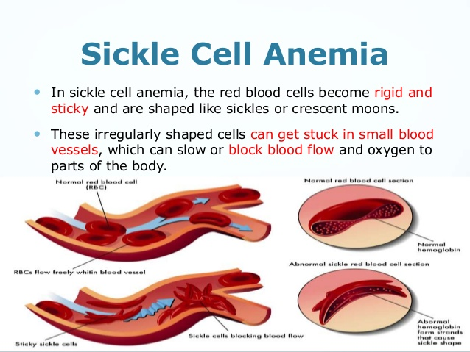
It is a genetic disease of human beings. This disease is caused by a recessive gene Hb^{s}.
The R.B.Cs in this disease become sickle-shaped in venous blood owing to the lower concentration of oxygen. This causes rupture of cells and severe haemolytic anaemia.
RBC- Deliver oxygen to the tissues

Slide 11
In sickle-cell haemoglobin glutamic acid is replaced by valine. The children homozygous for sickle-cell gene (Hb^{s}Hb^{s}) produce rigid chains. When oxygen level of blood drops below certain level, R.B.Cs undergo sickling.
Such cells do not transport oxygen efficiently they are removed by spleen causing severe anaemia.
Two individual with sickle-cell trait can produce children with all three phenotypes. Individuals of sickle-cell trait are immune to malaria.

Slide 12
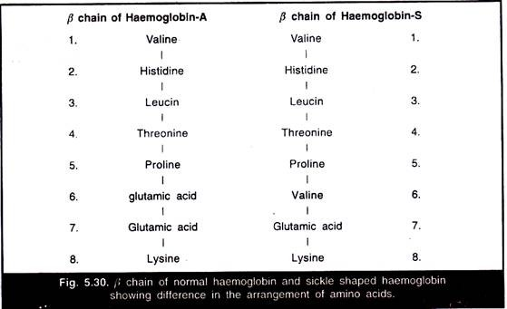

Slide 13
CHROMOSOMAL DISORDER
A chromosomal disorder occurs when there is a change in the number or structure of the chromosomes.
E.g. Down syndrome, Edwards syndrome etc.

Slide 14
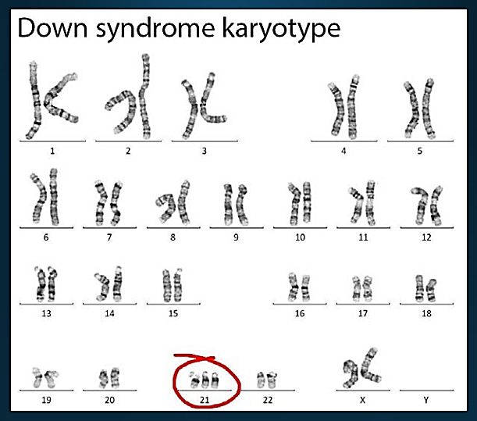
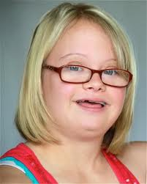
Down Syndrome
Extra copy of chromosome 21. Also called
“Trisomy 21”
1 in 1250 births
47 chromosomes
#21 trisomy nondisjunction
Short, broad hands
Rough skin
Mentally retarded
Small round face
Short lifespan

Slide 15
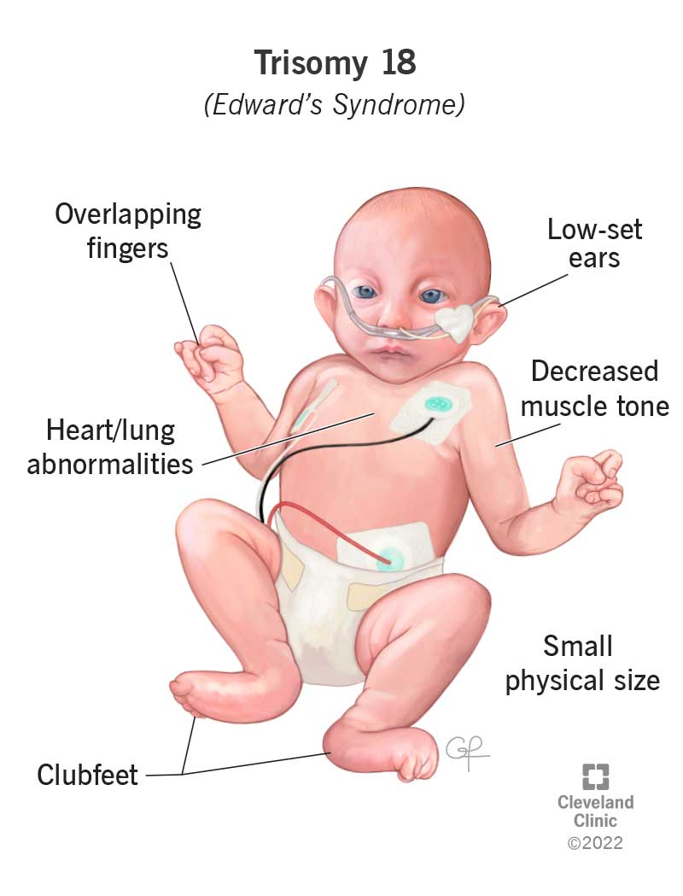
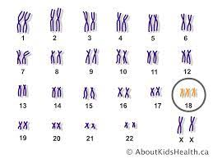
Edwards syndrome
#18 Trisomy
Abnormalities in many parts of the body.
Half of those born don’t survive past 1st week
Unusually small head
Mouth and jaw are small
Hands are clenched into fists
Congenital heart defects
Growth Retardation

Slide 16

THANK YOU

